Slide 1





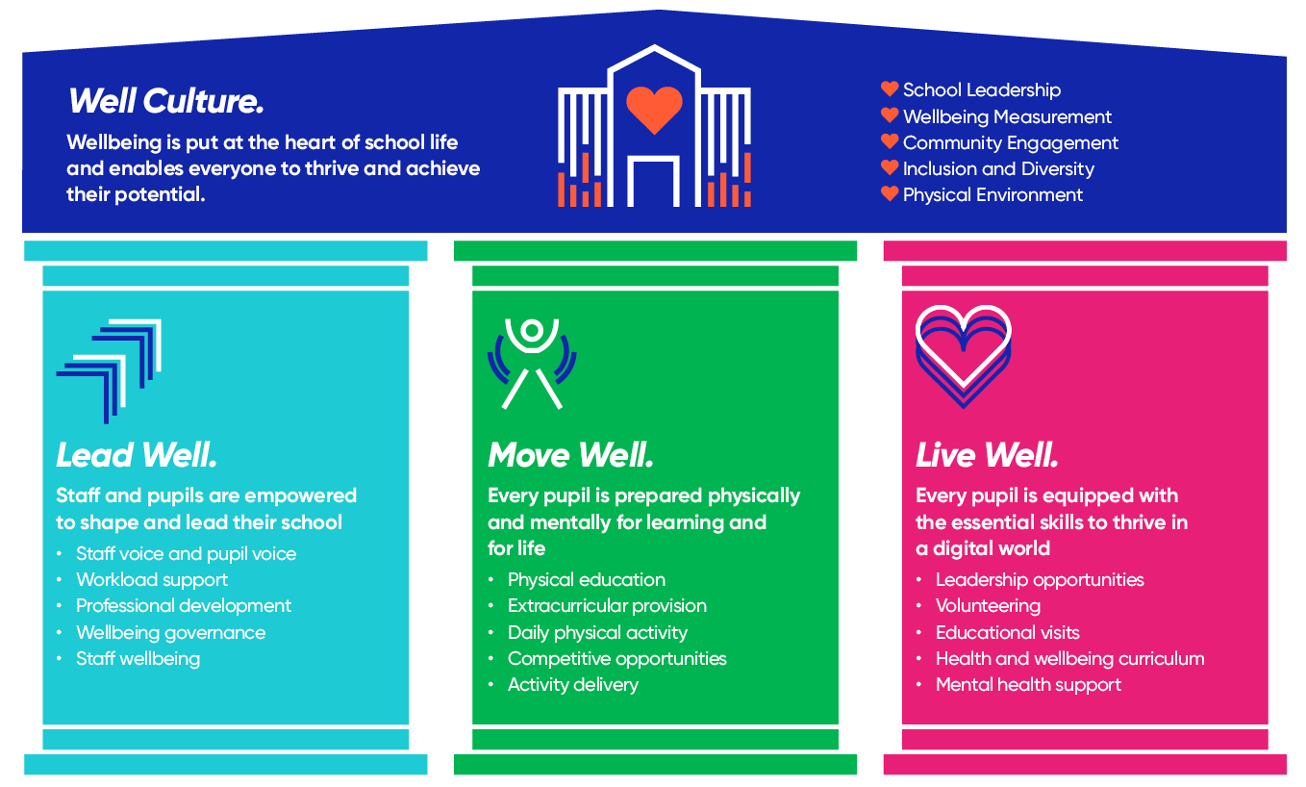
“A wide range of very useful advice, information…”
Well Schools Oxfordshire Partnership
⭐ Highlights from the Oxfordshire Partnership Event
Well Schools is a national movement of over 2,000 schools and trusts committed to improving education outcomes by prioritising the health and happiness of pupils and staff. In Oxfordshire, we are growing a strong local partnership bringing schools together to share best practice, learn from each other, and respond to local need.
Keynote from Adrian Bethune (Teachappy) on the case for Well Schools.
Schools shared practical action ideas such as:
Movement breaks & active learning
Calm/nurture spaces
Space Makers programme
Community‑integrated extracurricular offers
Workload and wellbeing‑focused staff policies
⭐ What Is a Well School?
A Well School places wellbeing at the heart of culture, leadership, curriculum and community.
School-led discussions on
Staff and pupil voice
Physical environment
Inclusion & diversity
Community engagement
Leadership & management
⭐ Why Headteachers Are Joining
Headteachers from across the country tell us that Well Schools helps them:
Strengthen school culture and ethos
Improve pupil readiness to learn
Support staff morale and workload
Demonstrate impact to governors and Ofsted
Connect with other schools facing similar challenges
Access national expertise and local support
“Opportunities to hear about good practice in other schools.”

Slide 2


⭐ Next Steps for Schools
Wherever you are on your Well Schools journey, there’s space for you in the Well Schools Oxfordshire Partnership
🔗 Complete your FREE Well Check:
https://www.youthsporttrust.org/well-schools
📧 Tell us you’d like to join the partnership:
wellschoolsoxfordshire@gmail.com
📅 Book your place for our next session on Tuesday 9th June
https://forms.gle/PvqFqY4tpm31JBi48
Oxfordshire Well Schools
37 schools completed the Well Check
8 schools started
1 accredited
Participation across primary & secondary settings
Free support available from partners
“Evidence shows that happier teachers and happier children make for better learning environments”

