Slide 1





Oxfordshire Virtual School presents: 2025 Annual Conference Transforming Lives Through Human Connection: Empowering Care-Experienced Children to Achieve Their Dreams

Slide 2
Together, we reflected on…
The power of human connection in transforming lives, especially for care-experienced children
What it means to be a “corporate parent” and the value of our professional roles
Personal experiences that deeply connected us to our work and its impact on care-experienced children
The hopes, dreams, and challenges faced by care-experienced young people in Oxfordshire
Strategies and innovations already in place to support care-experienced children’s needs
Insights from Ashley John-Baptiste’s keynote speech and how his story relates to our practice
Opportunities for sharing and learning from each other’s experiences
Areas needing attention and new ideas for supporting care-experienced children
Key actions and aspirations we are taking forward after the conference

Slide 3
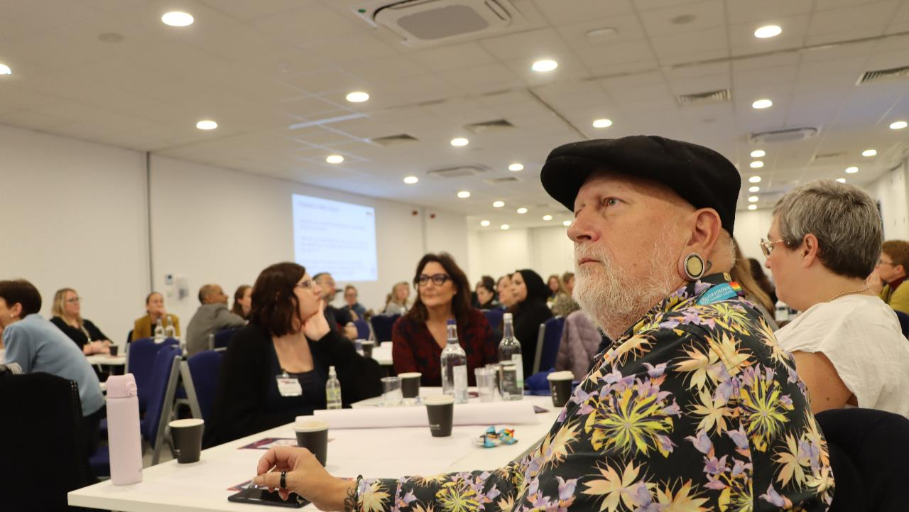
The day was designed to inspire and connect, starting with a keynote and followed by interactive sessions - Appreciative Inquiry, body mapping, Conversation Café and open space discussions - to deepen understanding and spark innovation in supporting care-experienced children.

Slide 4
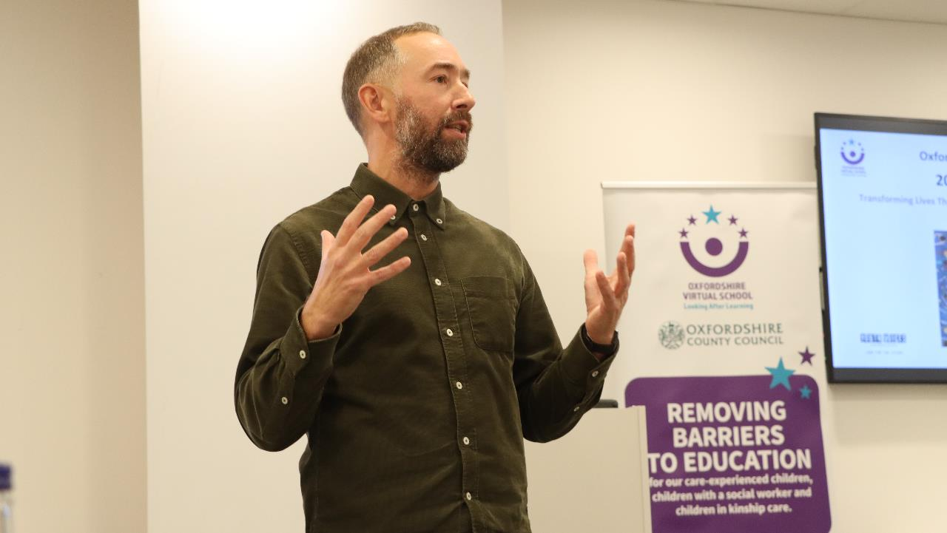

Slide 5
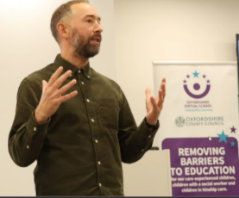
Appreciative Enquiry
3 questions 3 Roles 3 Rounds
How did you come to be doing the job you are doing? What led you here?
What do you value about the work you do and how do you believe your role adds value to the lives of children you care for?
Tell us about an experience when you felt deeply connected to your role as a corporate parent and the impact it had on the children you support?
Building connection
Encouraging reflection
Setting the tone for the day ahead

Slide 6
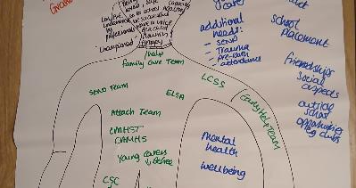
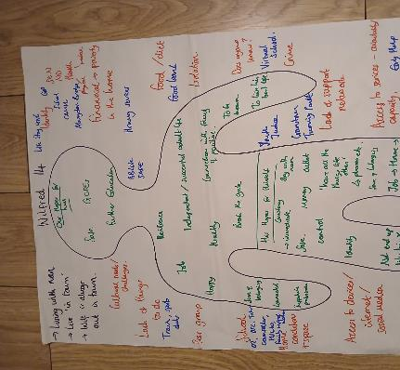
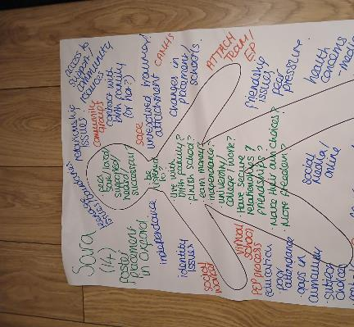
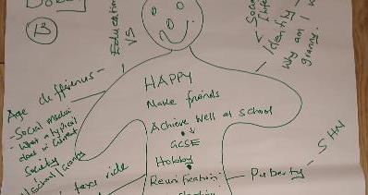
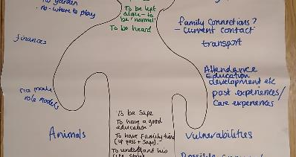
Body Mapping

Slide 7
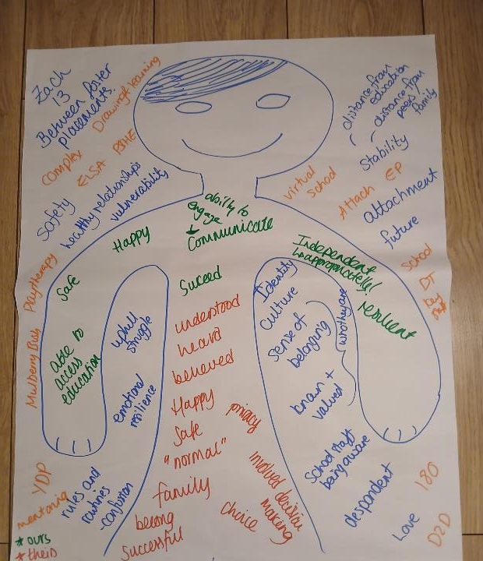
Collaborative Body Mapping: Sharing Our Insights and Expertise
What is their Name and Age?
Where are they currently living?
Thoughts, Feelings, Hopes and Dreams/Needs (inside the body)
Challenges- think about environmental, systemic & social (outside the body)
Identify strategies and innovations already in place to meet some of these needs and challenges (outside the body)

Slide 8
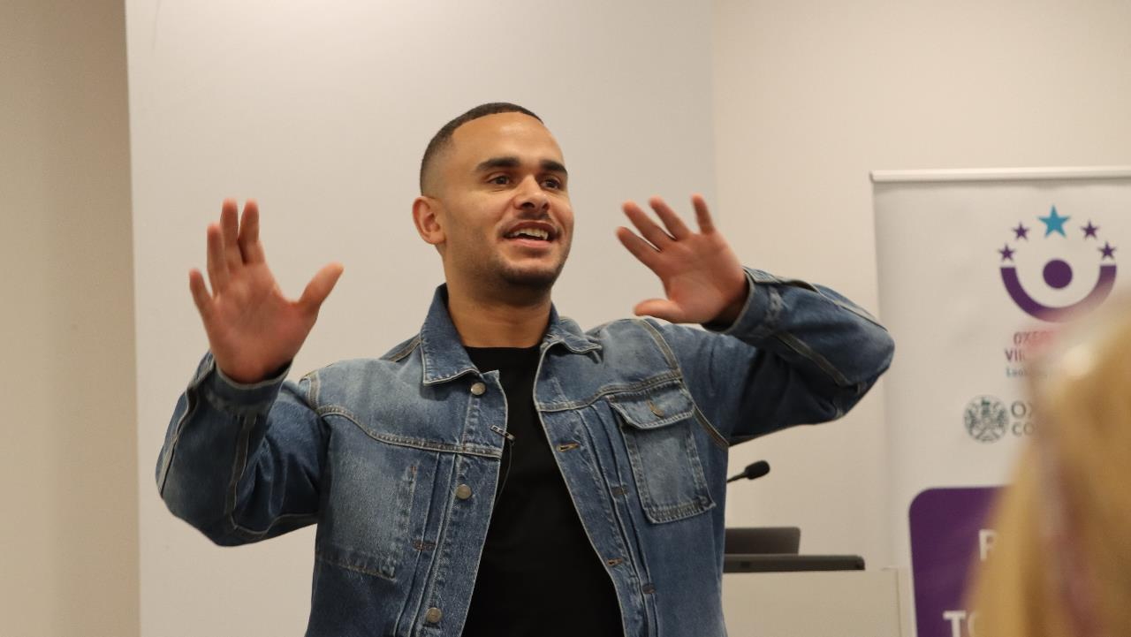
Ashley John-Baptiste

Slide 9
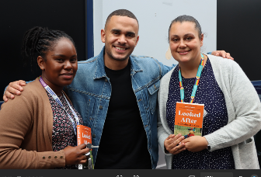
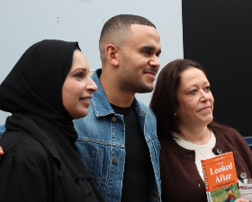
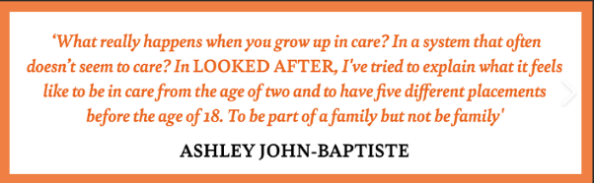
Ashley John-Baptiste: Broadcaster, TV Presenter, Author and Inspirational Speaker
Ashley John-Baptiste is an award-winning broadcaster and TV presenter, making reports & hosting The One Show, Sunday Morning Live, as well as Morning Live & BBC News.
Ashley is an inspirational speaker who shares his hard-hitting and inspirational story of navigating through the care system
.
Ashley’s debut book ‘Looked After: A Childhood in Care’ was published in June 2024 and was shortlisted for Hatchards and the Biographers' Club Best First Biography Prize.

Slide 10
Conversation Café
After hearing Ashley’s story what are you thinking? How are you feeling?
Ashley’s story challenges assumptions about behaviour and success. How should caregivers respond when a young person doesn’t fit expectations? What makes certain moments in relationships truly transformative for care-experienced children?
Ashley’s story was shaped by both adversity and connection. In your own role, what helps you to stay grounded in hope and relationship, even when systems or situations feel tough?

Slide 11
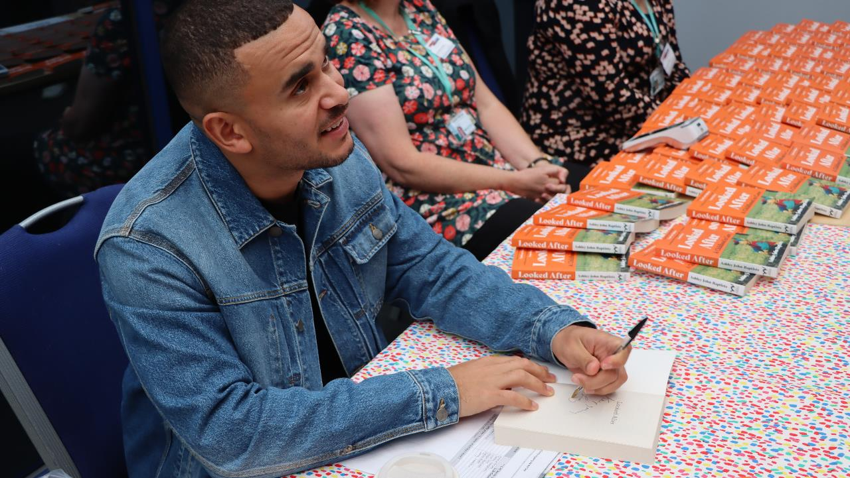

Slide 12
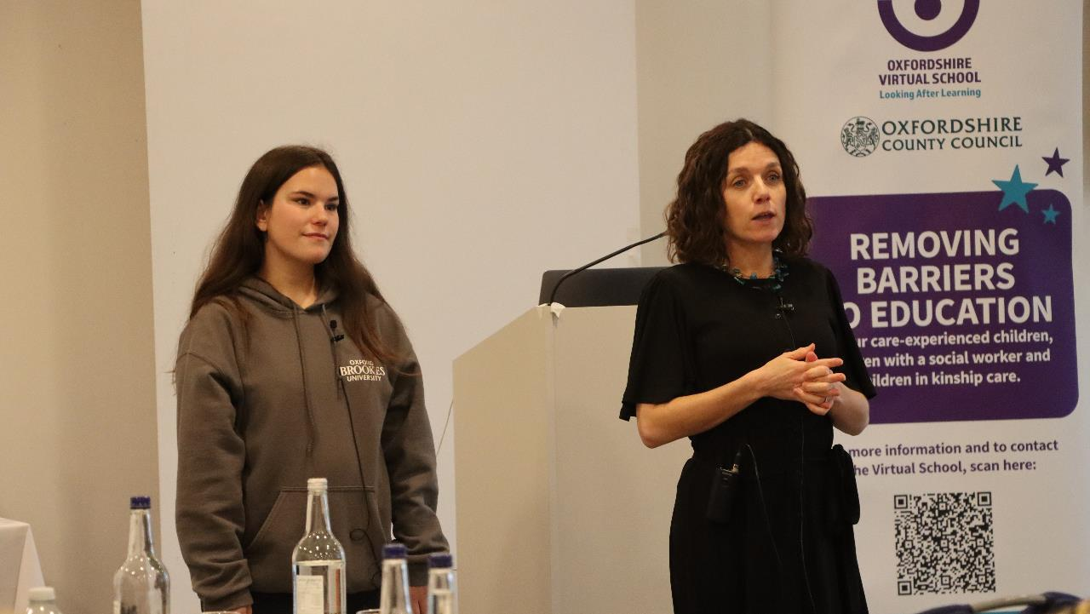
Brookes and Beyond

Slide 13
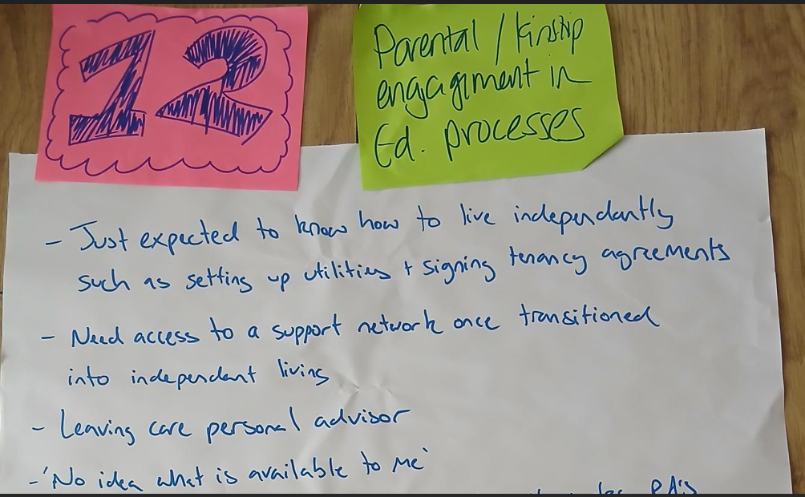
Open Space Discussions

Slide 14
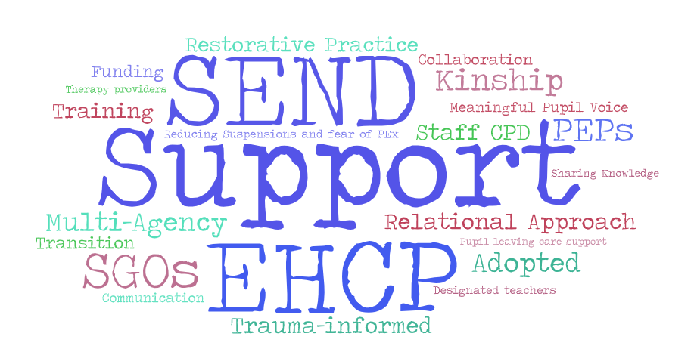

Slide 15


Annual Oxfordshire Virtual School Conference:
Transforming Lives Through Human Connection: Empowering Care-Experienced Children to Achieve Their Dreams
147 delegates
For me, the most useful part of the day was…
Ashley John- Baptiste, the Keynote speaker
Networking
My key take away was…
The conversation cafe prompted interesting thoughts and reflections following AJB’s session
A reminder of challenges faced by care leavers
Guest speaker and the afternoon group discussions
Being able to hear the diverse voices from around the room
Being able to connect with other professionals in the room
Reminding me why we do this
The table activities
Getting to have the big discussion at the end
Opportunity to reflect and connect

Slide 16


Annual Oxfordshire Virtual School Conference:
Transforming Lives Through Human Connection: Empowering Care-Experienced Children to Achieve Their Dreams
100% of delegates agreed that the conference inspired them to empower care-experienced children to pursue their dreams
Give one or two examples of how this conference will change your practice at a whole school level…
Holding in mind the child’s strengths and interests and how to help them reach goals in the time they are at school with us. Ensuring this is passed to future placements and schools.
Making sure pupil voice is part of all discussions.
I have been able to have the opportunity to speak to someone care experienced and be able to ask them how their social workers have failed them and be able to apply this to my practice.
Chance to further reflect and assess how my school do in supporting care-experienced children.
Really think about how we can encourage Children We Care for and Care Leavers to be aspirational about their future goals and to advocate and support them in achieving them.
Advocate for more support for adopted and SGO children in schools - through the PEP process.
”At a whole school level, I will advocate to provide a practical, support tool kit for our students before reaching the age of 18. Our students will have the opportunity to not just take home and read them but to discuss them in their tutorials …”
Have more restorative discussions with children. Ensure to keep the children's voice at the centre.
Having the courage to do things differently to bring about change.

Slide 17

Annual Oxfordshire Virtual School Conference:
Transforming Lives Through Human Connection: Empowering Care-Experienced Children to Achieve Their Dreams
*280% increase rate in delegates knowledge and understanding of how to create a supportive environment for care-experienced children
*The absolute change is 84 points (from -30 to 54).
The percentage increase is calculated relative to the magnitude of the original score 84/-30 x100=280%
What further support and training would you and your setting benefit from as you seek to implement learning from the conference?
More training around Kinship Care, SGO and support for adopted children.
Training that can be presented to all staff at all levels to cover the basic foundations of CWCF.
Practical support for supporting young children (primary) who have been CWCF/adopted/kinship SGO or fostered.
Transition work from secondary school to college
More support on how to use funding to support CWCF children
Advocate for more support for adopted and SGO children in schools – through the PEP process
Exploring extended provisions for previously care experienced children

Slide 18
Annual Oxfordshire Virtual School Conference:
Transforming Lives Through Human Connection: Empowering Care-Experienced Children to Achieve Their Dreams
Is there anything else you would like to feedback to us about the content of the conference?
A fantastic conference!
A well led conference with a strong theme throughout
The new format was really useful, and Ashley was inspiring to listen to
It was really great - loved the theme of connection, and meeting everyone and hearing their stories
Super balance of input and discussion
I liked who it wasn’t like a typical conference. It was much more engaging, interactive and I feel I took more away because of it
It was a welcome change from a traditional conference setup
Enjoyed the interactive element of the conference. The keynote speaker was incredibly powerful and thought provoking
I really enjoyed the structure of the day - very engaging and interactive and I met lots of interesting people. Good networking opportunity
Very well thought out and enjoyable conference. Tom and Anna held the space beautifully
Brilliantly delivered, fun and engaging, thought provoking

