Slide 1
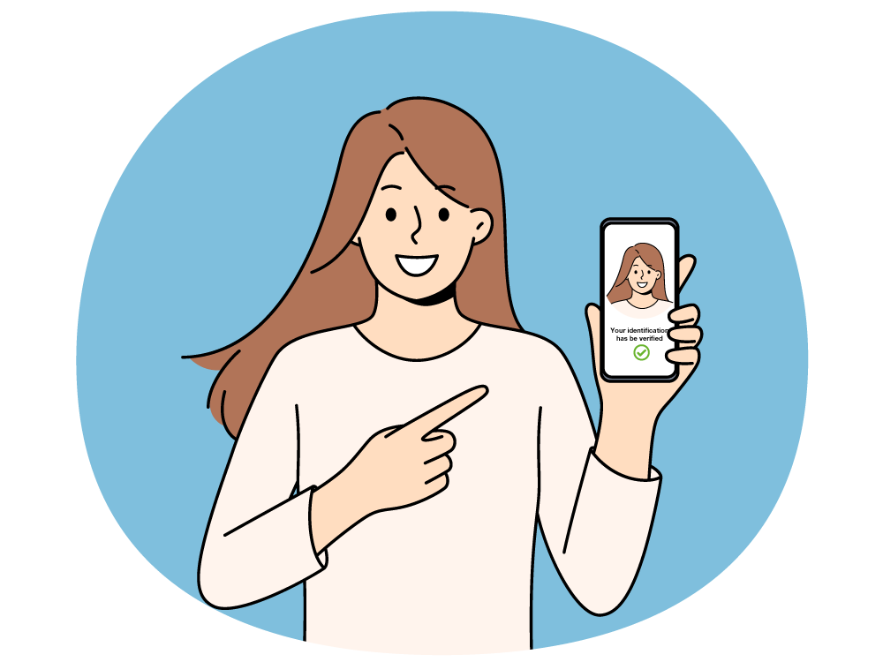
Take Charge of Your Health
With the NHS App
Learning materials for young
people (ages 13+)
Prepared by Marta Fischer Digital Transformation Manager at NHS BOB ICB
Email: Marta.Fischer2@nhs.net

Slide 2




Why Should Young People Care About Their Health?
Helps you stay healthy and make informed choices
Builds confidence in managing your own health
Encourages independence and responsibility
Puts you in control of your health journey
JB

Slide 3

What is the NHS App?
The NHS App is a mobile application which can be downloaded to a mobile or tablet. It is a mobile application of NHS Account.
NHS APP provides free and secure way to access NHS services and manage your health.
NHS APP
JB

Slide 4
Top 5 NHS APP Features You’ll Love
📅 Book GP appointments
💊 Order repeat prescriptions
📁 View your medical records
🔍 Check symptoms with NHS-approved advice
💉 See your vaccination record (e.g., COVID-19)
FS

Slide 5
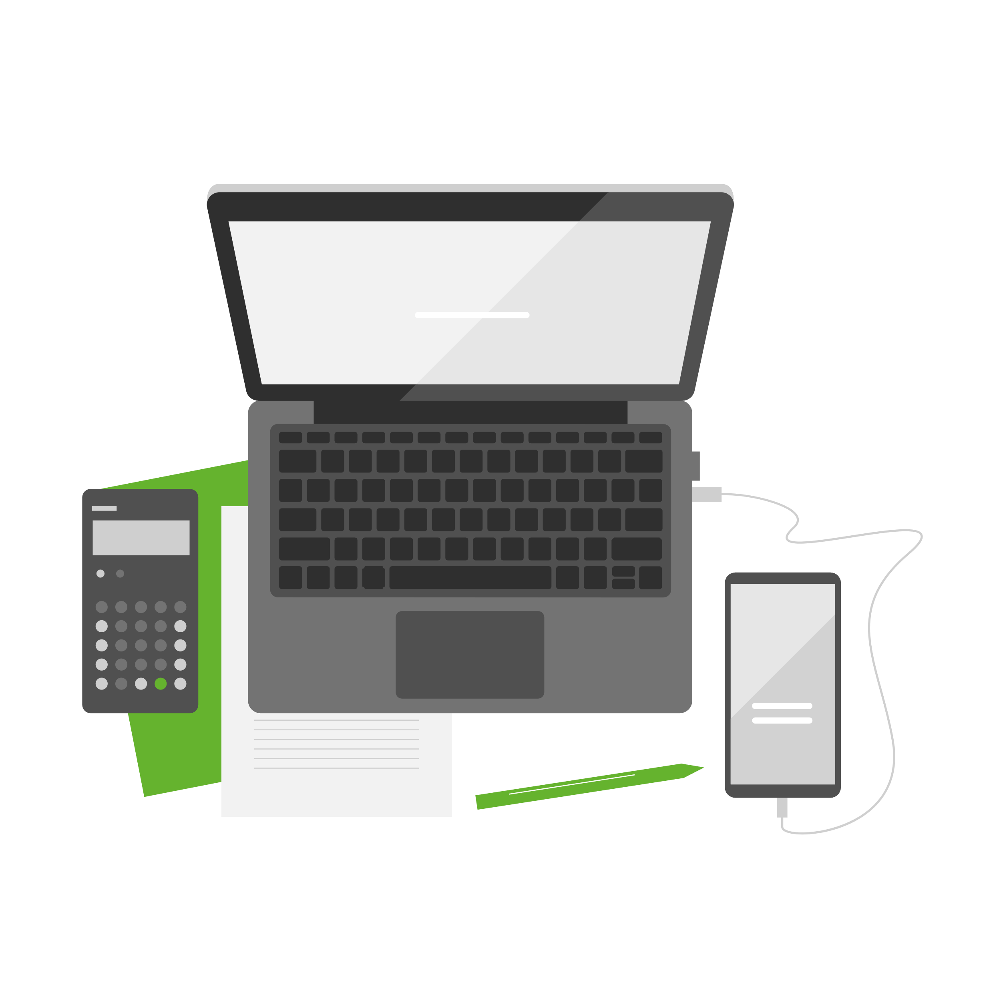
When and How Can You Start?
You can start using the NHS App at age 13
Download it from the App Store or Google Play
Set up a secure NHS login
Your data is protected and private
FS

Slide 6
Common Questions
🔐 Is my data safe?
Yes, your information is protected.
👨‍👩‍👧 Can my parents see it?
You have your own secure login.
💷 How much does it cost?
It’s completely free.
📲 Do I need to go to a GP to sign up?
Not necessarily – you can open an NHS account online, but you need to be registered with local GP online.
FS

Slide 7
Extra Resources
🔗 Download: www.nhs.uk/nhs-app
📹 YouTube: 'How to use the NHS App’
📄 NHS England : Promotional materials
FS

Slide 8
Thank you

