Slide 1

IBC and Employee Self-Service
Differences

Slide 2
Introduction
This pack shows the differences between the current Integrated Business Centre (IBC) and Employee Self-Service (ESS) (which uses SAP ECC system) and the upgraded IBC and ESS (which will use SAP S/4HANA system)
The changes have been identified so far throughout the conversions and testing
The IBC and ESS will be largely the same as they are today

Slide 3
IBC and ESS

Slide 4
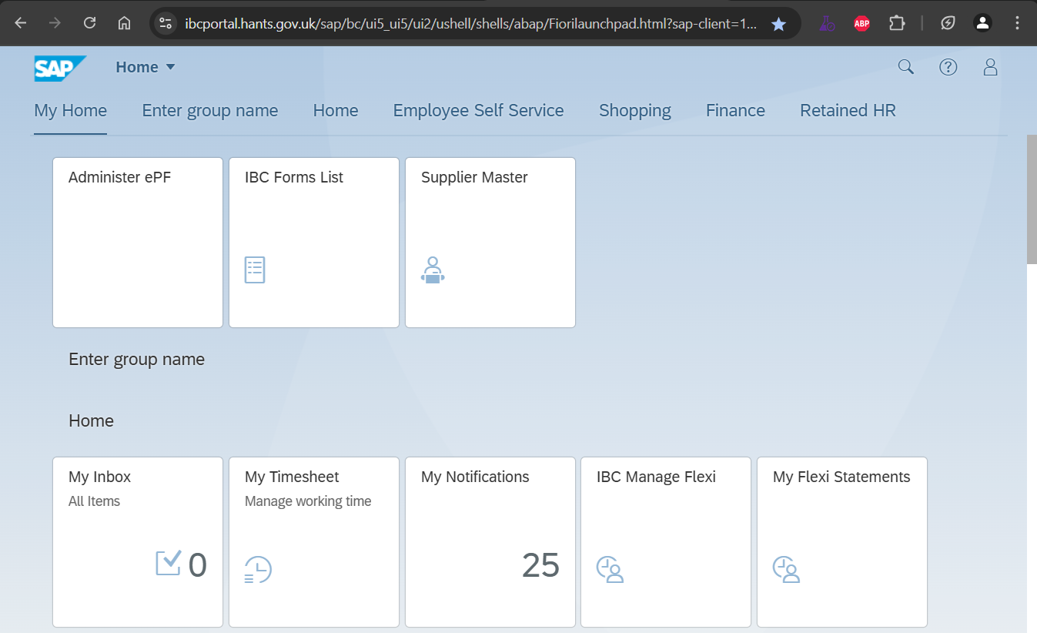
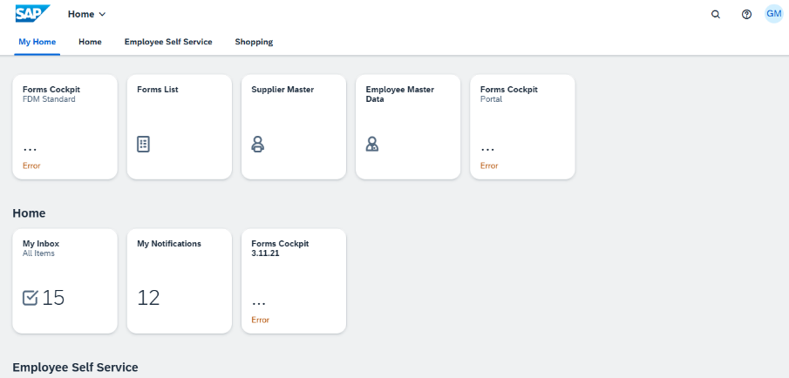
Home screen
Change shown below. If you have previously changed your theme in ESS/IBC portal your chosen theme will remain
Current
Future
Current
Future
The person icon has been replaced by the user's initials

Slide 5
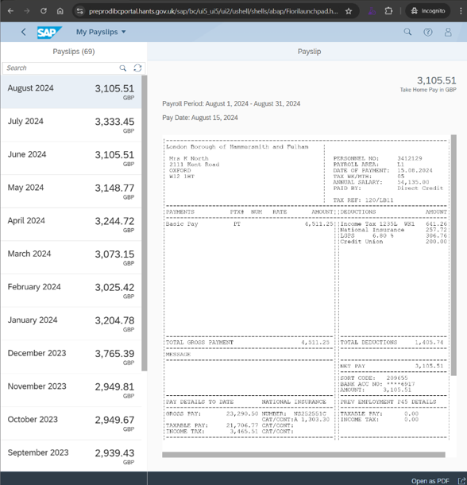
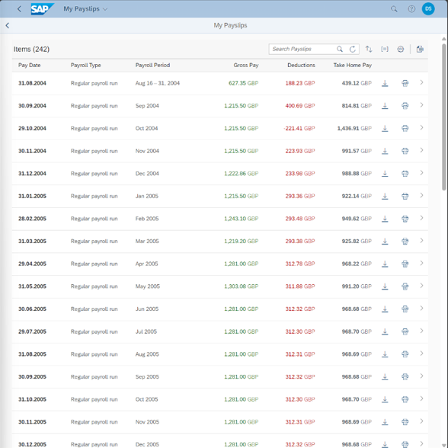
Future
Current
Payslips
There is a change to what you will see.
When you look at your payslip you will see a summary table of payslip information instead of the split screen format we have currently.
Most recent payslip is at the top of the table.
Gross pay, deductions and take-home pay are shown on screen.
You can download individual payslips or export the summary data to Excel.

Slide 6
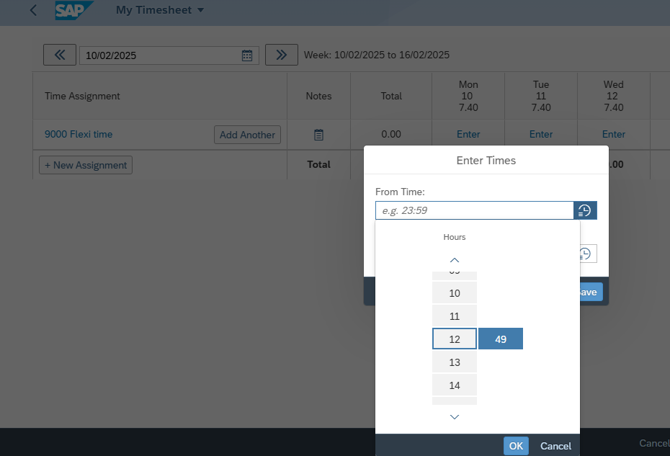
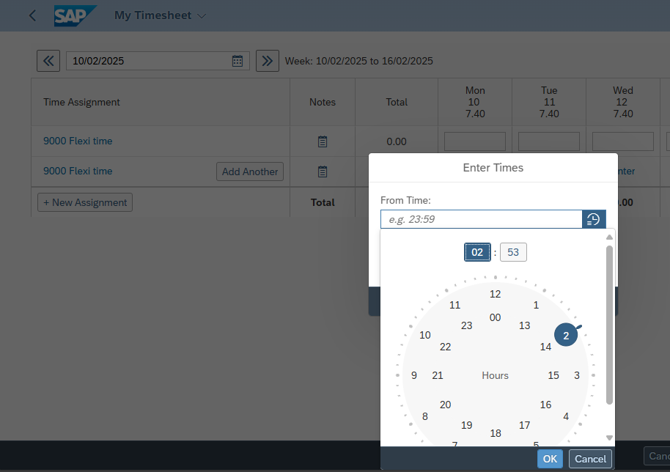
Timesheet
Current
When you select to record time using clock-in times, you can currently either enter time manually or scroll through times in a drop down.
In future you will continue to be able to enter time manually but will see a clock face instead of the drop down.
Future

Slide 7
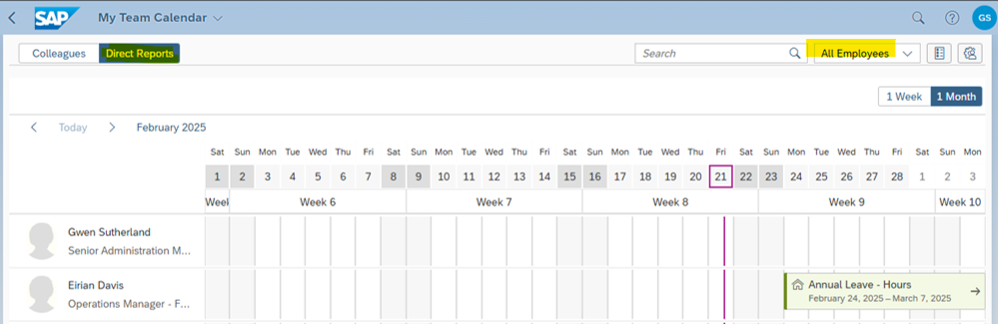
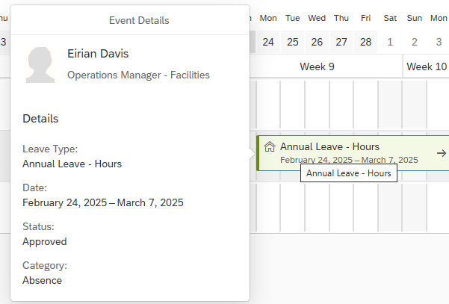
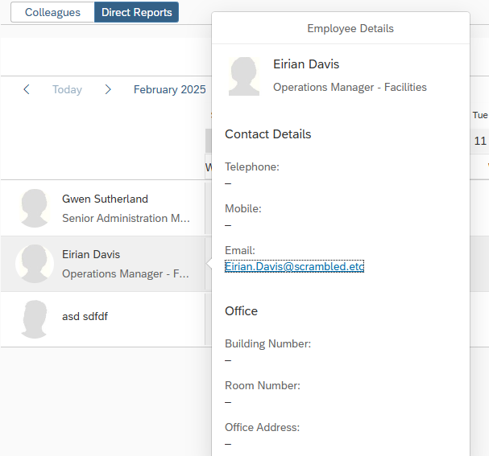
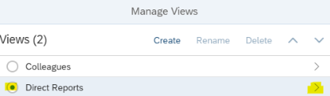
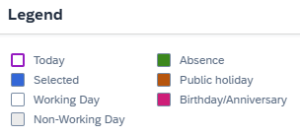
Team calendar
In future
The 'Direct Reports' tab displays all employees who report to the manager, including teams that sit under them.,
Users can filter the screen to show ‘all employees’, ‘absent’ or ‘available’
When you select an absence on the calendar, the details of the employee and the absences are displayed.
When you select an employee, their email address will show. Clicking it opens a new Outlook window.
Updated, more accessible key.
‘Manage views’ allows you to manage how information is displayed in your calendar, selecting 'Direct Reports' option allows you to show or hide records of their direct reports.
If you have external contractors in their structure, these records will now show on a separate tab of the calendar

Slide 8
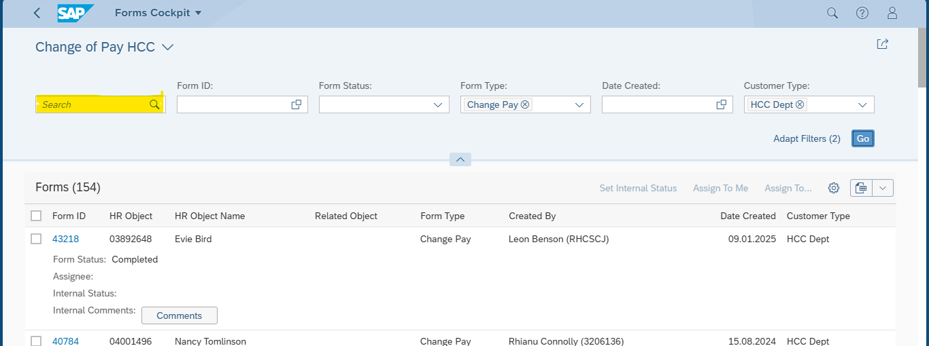
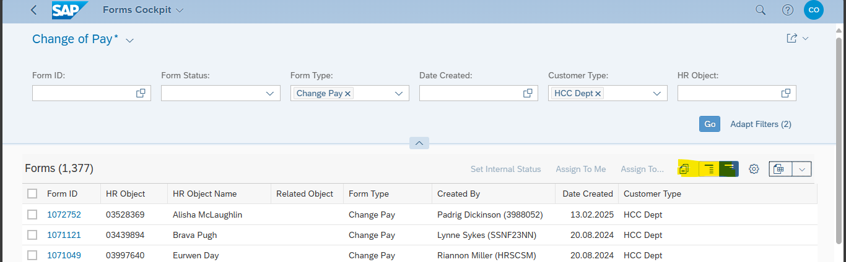
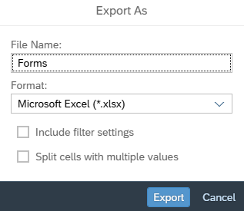
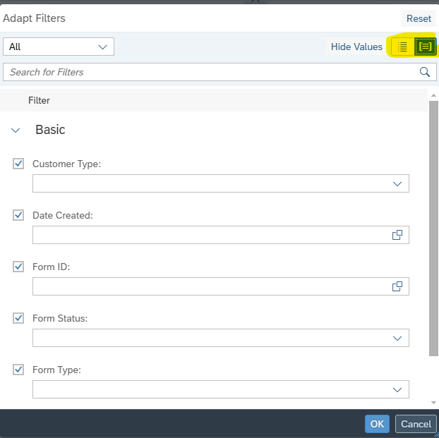
Forms
Current
There is a change to what you will see.
The ‘free’ search bar is no longer available
New ‘Copy to clipboard’ allows you to copy and paste details of selected forms to another document
New ‘Show more’ allows you to show more details of form per row
New ‘Show less’ allows you to show less details of form per row
The ‘Export’ window layout has changed. A format field has been added to choose the file type. The 'Split cells with values' checkbox now appears above 'Include filter settings’.
Adapt filters option will let you swap between ‘List’ view and ‘Group’ view.
Future

Slide 9
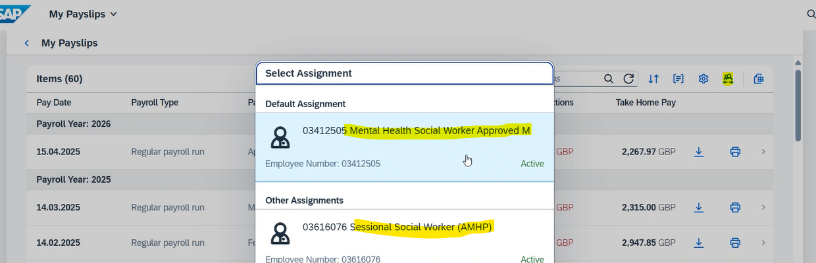
Multiple employment
When you log in using a personnel record which isn’t your main record and look at ‘My payslips’ or ‘My leave Requests’, the information will now default to display information from your primary record.
You can manually switch to your non-primary record.
This is an improvement for ‘My payslips’.
For the ‘My leave requests’, will need to make sure you submit leave requests on the correct record.
There are no changes to ‘Expenses’ and ‘Timesheet’ —they continue to display data based on the personnel number you have logged in with.
The INC help and guidance pages are being be updated to reflect the change.
Future

Slide 10
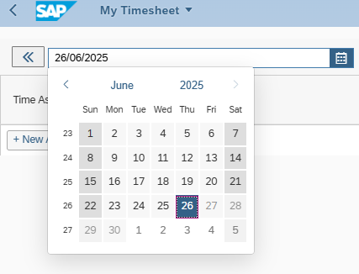
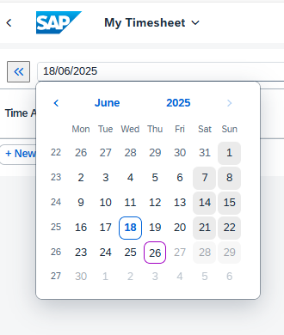
Date pickers
Current
The calendar you see when selecting the date picker will display Monday as the first day of the week.
Future

