Slide 1
IBC changes
Approach and impacts
Oxfordshire County Council
2025

Slide 2
Changes to IBC
The system behind the Integrated Business Center (IBC) is SAP and the Shared Services Partnership is upgrading this to SAP S/4HANA
Information and data will be ‘lifted and shifted’ from the existing SAP system to the updated version
IBC is working as usual
Testing plans have been shared
There will be a period of time when all IBC systems (including SAP) won’t be available, as the existing system switches over to the new one
Future opportunities
There will be opportunities for improvements once SAP S4/HANA is in place and this is being managed through the Shared Services governance process, though engagement with all partners

Slide 3
System switchover
The final move to S/4HANA requires system downtime
The teams in Hampshire will be working 24 hours a day, on a rota basis, during the outage period to minimise the period of downtime
Key dates:
Outage begins at 6pm Wednesday 24 September
Aim is for all users to be able to access the system from 8am on Thursday 2 October
Once the system is released back to users, there will be a two-month period of hypercare (followed by stabilisation)
Mon 15 Sep | Tue 16 Sep | Wed 17 Sep | Thu 18 Sep | Fri 19 Sep | Sat 20 Sep | Sun 21 Sep | Mon 22 Sep | Tue 23 Sep | Wed 24 Sep | Thu 25 Sep | Fri 26 Sep | Sat 27 Sep | Sun 28 Sep | Mon 29 Sep | Tue 30 Sep | Wed 1 Oct | Thu 2 Oct | Fri 3 Oct | Sat 4 Oct | Sun 5 Oct | Mon 6 Oct
Technical tasks (pre-outage)
Planned outage for S/4HANA conversion
Contingency
Reports data refresh TBC
Final readiness assessment and recommendation to SDB to authorise cutover start
Outage starts
(6pm Wed 24 Sept)
Systems should be released back to all users (8am Thu 2 Oct)
The plan includes a contingency window from Thursday 2 October to Sunday 5 October
This would be used in the following scenarios: A critical issue (e.g. serious system instability, inability to run payroll) which needs more time to resolve
Reporting and data extracts may not be fully available when systems are initially released back to users. This is subject to detailed planning and will be confirmed by Shared Services

Slide 4
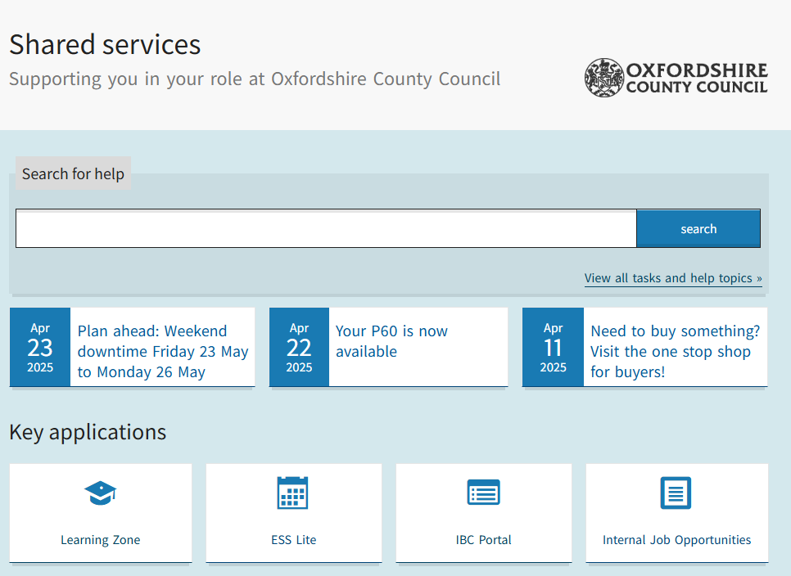
Which services will be unavailable?
The following services will be unavailable at switchover
Learning Zone
Employee Self Service (ESS Lite)
IBC portal
SAP GUI (access directly into the SAP system, limited number of users)
Supplier Self-Service
Customer Self-Service
Councillor Self-Service
Volunteer Self-Service
Outbound interfaces and data extract files
Which services will remain available?
The following services will remain available
Webchat, with agents providing generic guidance/advice
ePayments and telephone payments can still be made
Guidance pages will remain available, this is where users can access webchat

Slide 5
Impacts – payroll and payments
September payrolls will be completed before the period of downtime begins
There is no change to the date that employees will receive their pay in either September or October
The final payment run, before the outage, will be completed at 2pm on 24 September
Providing the contingency period is not required we expect to complete the first payment run after the outage at 2pm on 2 October
Purchasing cards, petty cash
Can still be used during the outage period
Any requests to increase limits must be completed well in advance of 24 September

Slide 6
Impacts – interfaces and reporting
Reporting
Portal reporting will be unavailable during the outage period
Reporting may not be immediately available when the system is back up and running. More details to follow from Shared Services
As part of the OCC transformation programmes, we now have finance and HR data which can be used while IBC reporting is unavailable, but this will be a data cut from 23 September

Slide 7
Planning in Oxfordshire
Oxfordshire County Council Shared Services’ leads and subject matter experts are in the process of developing an engagement and business readiness plan.
The plans will ensure
messages are communicated to schools
we are prepared for the downtime and understand all changes to processes during the downtime
Any questions at this stage, contact the School Improvement team: schoolimprovementteam@oxfordshire.gov.uk

