Slide 1
Free School Meal updates
June 2025

Slide 2
Recent Government updates
Transitional protections have been extended until the end of the 2025/26 school year. All pupils becoming eligible for free school meals under the benefits-based criteria, should continue to receive this entitlement, regardless of any change in household circumstances or phase of education until the end of the 2025/26 school year.
From the start of the 2026/27 school year, the Department for Education will introduce new eligibility criteria meaning that all children from households in receipt of Universal Credit will be entitled to receive a free meal. It is our intention to end transitional protections alongside this change in threshold, with eligibility for all pupils reverting to whether they meet the eligibility criteria regardless of whether they were previously protected.
From the beginning of the 2026/27 academic year, schools and local authorities will need to keep free school meal eligibility under continued review. Schools and local authorities should recheck eligibility for all pupils in receipt of free meals, ahead of the October census.
Free school meals

Slide 3
Early Years Foundation Stage nutrition guidance
From September 2025, the EYFS statutory framework will include a safeguarding and welfare requirement that asks providers to follow this nutrition guidance unless there is a good reason not too.
This guidance will support providers to understand how to implement the existing EYFS requirement that states: ‘Where children are provided with meals, snacks and drinks, these must be healthy, balanced and nutritious’.

Slide 4
Free School Meal campaign
The Department for Education (DfE) estimates that 11% of children who may be entitled to receive Free School Meals (FSM) are not registered to claim them.
At the end of June 2025, 3 district councils (Cherwell, Oxford City and West Oxfordshire) will be launching a targeted campaign to increase the uptake of free school meals.
Families who are identified as being eligible for FSM will be sent a letter, explaining why we are encouraging them to take up their entitlement and how to apply. Therefore, you may have more families contacting your setting to ask about FSM. Eligibility should be checked in the normal way.
If there are specific queries you need support on, please email free.schoolmeals@oxfordshire.gov.uk

Slide 5
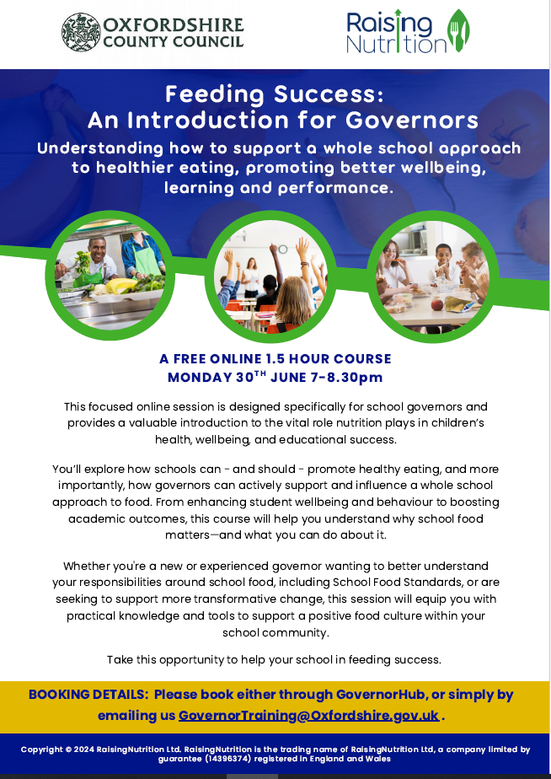
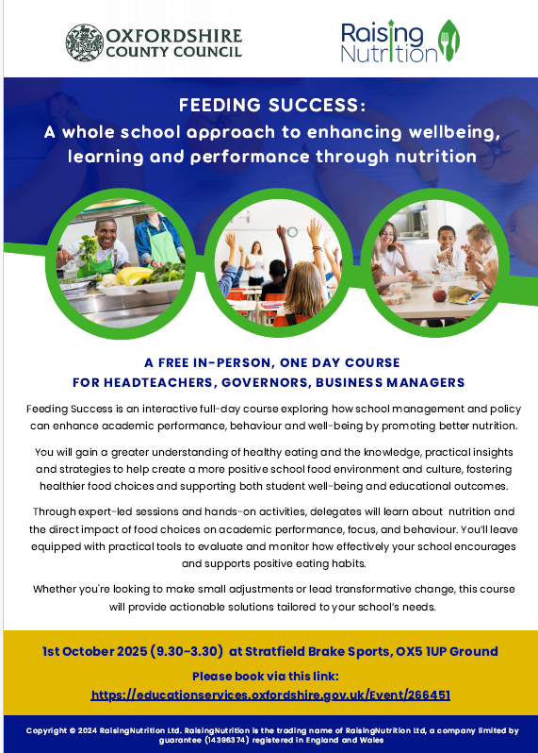
Contact Natalie,robb@
oxfordshire.gov.uk

