Slide 1
Winter Warmth 24/25

Slide 2
Wider/Strategic links
UKSHA Adverse Weather Planning - national update on winter plans
Coms based on this and the following reports/plans
NICE Guidance on Excess Winter deaths
Cold Weather Planning
Warm spaces: public libraries to offer heat, help and hope this winter | Libraries Connected!
Linked to supporting BOB ICB Winter Pressures plan - reducing demand

Slide 3
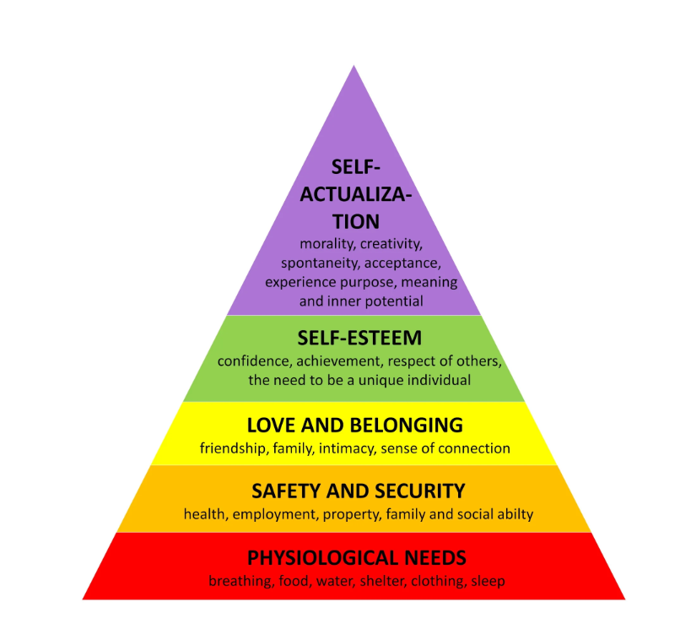
Housing
Housing a key building block to good health
Mental health: 28% of children living in cold homes are at risk of multiple mental health symptoms, such as anxiety and depression.
Physical health: Cold homes can impair children's lung and brain development, and increase the risk of respiratory problems.
Academic performance: Children growing up in cold homes perform less well in school.
Notes:
https://www.ucl.ac.uk/news/2022/sep/marmot-review-thousands-will-die-and-millions-will-suffer-humanitarian-crisis-fuel-poverty#:~:text=Fuel%20poverty%20is%20driven%20by,and%20a%20disordered%20immune%20system.
https://www.instituteofhealthequity.org/about-us/about-professor-sir-michael-marmot#:~:text=In%20February%202020%2C%20Professor%20Marmot%20and%20the,to%20the%20'Fair%20Society%2C%20Healthy%20Lives'%20review.

Slide 4
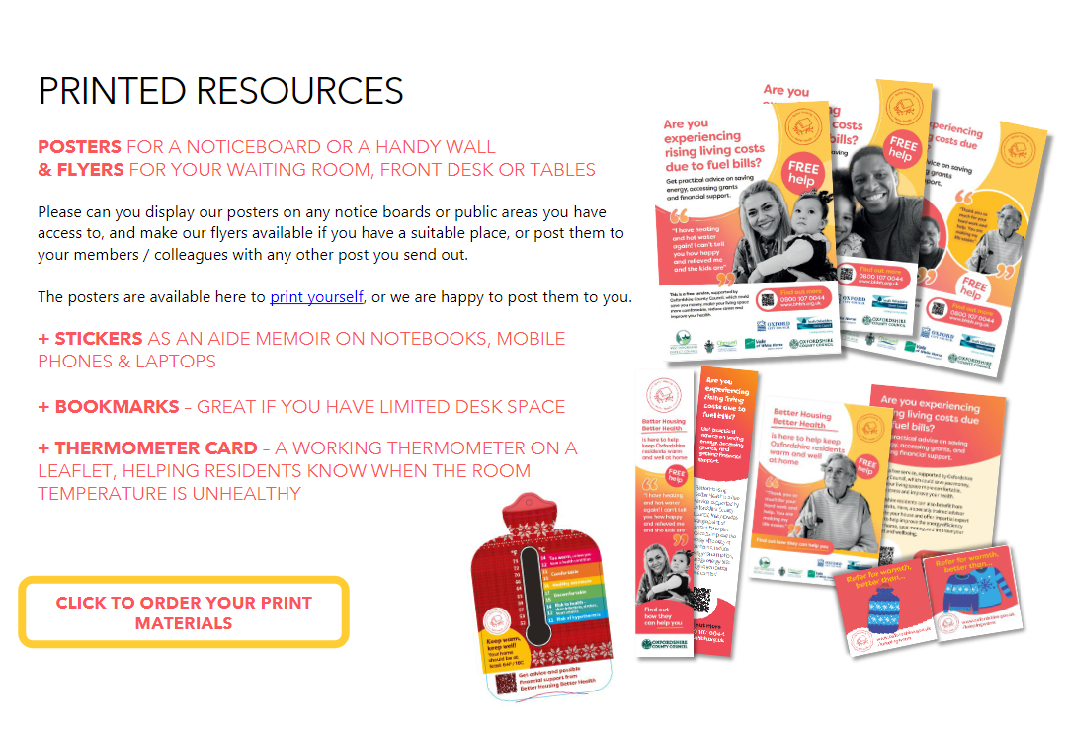
Established communications pack to be sent to partners
Includes printed materials on order – posters, bookmarks, stickers, thermometer cards
Joint messaging with Libraries (warm space) and Climate Action team on Energy Saving App on thermometer cards

Slide 5
Warm space - Welcome to stay for as long as needed
More than books! Eg board games, jigsaw puzzles
Provide hot drinks
Events and activities
Digital helpers, access to the internet

Slide 6
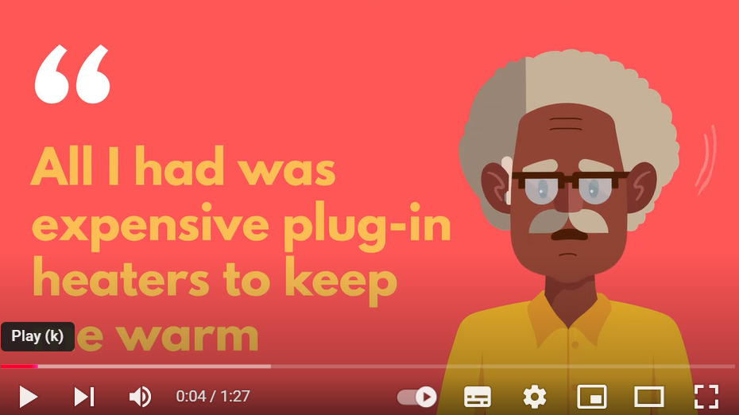
Better Housing Better Health service.
Jointly commissioned with Districts/City and Adult Social Care and Public Health.
Provides advice and information on staying warm, access to energy efficiency grants. Includes telephone advice as well as home visits .
Recommended by NICE Guidance on Excess Winter Deaths and has been evaluated.
Watch one of two explainer videos – click right
Additional funds from Household Support Fund to provide emergency fuel vouchers or other measures (heated blankets, slow cookers) to help stay warm or reduce energy usage.

Slide 7
Other Partners
Children and Young people – Care Leavers – developing images to go with coms materials of younger people
Health -Integrated Neighbourhood Team – raising profile of coms campaign to this group
NHS/Health - BOB ICB supporting Cold and Unsafe Homes Referral Pathway and promotion to primary care and liaison with Oxford Healths health promotion unit
Gypsy and Traveller communities – tailored advice and outreach
Migrants - translation
Adult Social Care – mail out to vulnerable residents, based on social care usage and mapping to EPC rating.
Schools…?

Slide 8
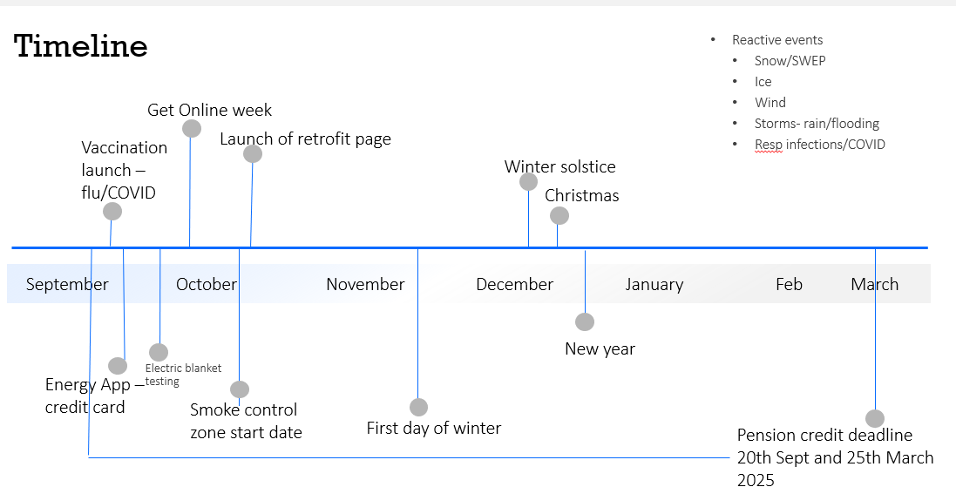
Campaign timeline – timely and relevant winter messages over social media planned, amplifying partners winter messages. Under development.

Slide 9
The Ask
1) Read and make use of the coms toolkit
2) Share some of the messaging with relevant staff – eg who occurs to you?
3) Order and share the publicity material with staff, parents
4) How could we tailor this campaign to resonate, be more meaningful and helpful to schools?

Slide 10
Get in touch with ideas healthyplaceshaping@oxfordshire.gov.uk

