Slide 1
Free breakfast clubs

Slide 2
Breakfast club commitment
The government is committed to offering a free breakfast club in every primary school in England.
This will build on the national wraparound childcare programme and national school breakfast programme.

Slide 3
The early adopter scheme
The programme will invite up to 750 state-funded schools in England with primary aged pupils to work with the DfE. It will focus on how breakfast clubs can be delivered in a way that:
Builds on what is already happening in schools
Meets the needs of the parents
Ensures children start the day ready to learn.
DfE will also work with the sector including local authorities and childcare providers, businesses and charities to consider the best approaches to delivering the breakfast clubs in schools.
Early adopter schools will be confirmed by early 2025 and the scheme will launch in the summer term (April 2025).

Slide 4
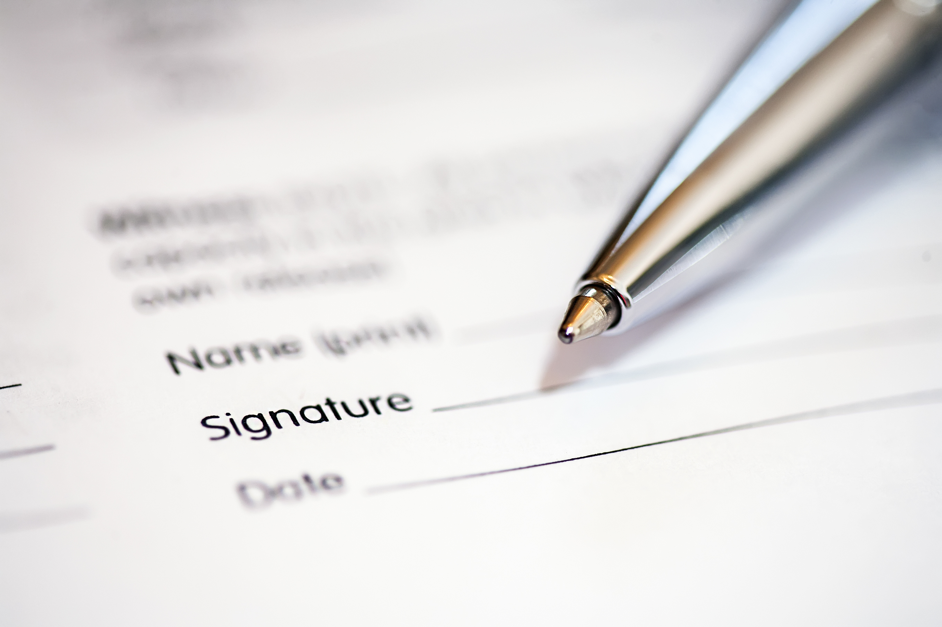
Register your interest
Schools that wish to find out more about becoming an early adopter can sign up using the early adopter breakfast clubs expression of interest form to be notified as further information becomes available.
Reminder
All food available during the whole of the school day should adhere to the School Food Standards. Further information can be found here.

