Slide 1
Becoming a Restorative School Clare Pike Lead for Learner Engagement

Slide 2
Training Content 117 mins max (approx. 2hrs) / Upto 3hrs if you inc. skills practise
Why Restorative Practice? 03:49
What is Restorative Practice? 06:46
Restorative Values and Principles - 10 mins?
Characteristics of a Restorative School – 5-10 mins
Whole-school approach to meeting people’s needs – 5-10mins
Considering it in context – approx. 9 mins
Social Discipline Window 13:01
5-Step Practice framework 19:20
Demonstration of a 5-Step Conversation approx. 25 mins
Optional skills practise - 1:1 conversation
Restorative Scripts and Other Tools 09:20
Optional skills practise - meeting
Additional Sources of Information and Support

Slide 3
Thinking point…
“We all need to feel that we belong – connectedness is a key factor in our sense of well-being. We care about those we feel connected to and we value their good esteem. These social bonds build community and safety because they are based on mutual empathy, care, consideration and respect. This is the environment needed, for example, in school for effective teaching and learning to take place.
When disconnection happens through conflict, ways need to be sought as soon as possible to create re-connection. A disconnected person will feel excluded from empathy, care, consideration and respect, and is less likely then to display these with others. A disconnected person is an alienated person. An alienated person feels threatened and in turn poses a threat. Conflicts disconnect people.”
Belinda Hopkins, Transforming Conflict
Notes:
Working restoratively is about reaching out and seeking ways to connect/reconnect and avoiding people ever feeling disconnected/isolated. Ideally, you have a whole-school approach that works to prevent relationship breakdown/conflict but this could never be 100% full-proof. This training will consider strategies that you can embed to reduce the likelihood of conflict and will teach you about the 5 restorative steps (an evidence-based framework) that can be transformative and support you in working through challenging situations with children, colleagues and parents.

Slide 4
Module 1 – Why Restorative Practice?
https://vimeo.com/729238807/d9069bed57

Slide 5
Module 2 – What is Restorative Practice?
https://vimeo.com/729240710/4aa0245bb7

Slide 6
Module 3 – Considering it in context [Primary Clip]
https://vimeo.com/729242370/52a1678202

Slide 7
Module 3 – Considering it in context [Secondary Clip]
https://vimeo.com/729243624/4e624d0a1b

Slide 8
Dr Brenė Brown on shame, guilt and vulnerability
https://youtu.be/GdllwCXDyTA

Slide 9
Summary
Shame is often the root cause of destructive behaviours
It’s not helpful to be ashamed
Shame corrodes the part of us that believes we can change
Guilt is “I did something bad” – doesn’t feel good when compared to the sort of person you aspire to be
Shame is “I am bad”
Guilt is generally at the heart of authentic reparation
Secrecy, silence and judgement feed shame
Shame cannot survive being spoken about and met with empathy
Who we are when we are vulnerable is instrumental to shame resilience.
Goal of restorative work is to develop empathy – “Empathy makes any problem soluble” – Professor Simon Baron-Cohen
If we are restorative, how we support people when they are vulnerable should result in empathy and not shame
Empathy Shame
VULNERABILITY

Slide 10
Paired discussion What do we need when we are vulnerable?
Think of someone who - as an adult or a child - helped you when you made a mistake or were going through a difficult time. A time of vulnerability.
What were the qualities that you appreciated at the time? Are these qualities what you expect a child would wish for in you?

Slide 11
Restorative Values and Principles Record the input of staff from discussion
Notes:
Creating a safe environment

Slide 12
Characteristics of a Restorative School

Slide 13
Restorative Organisation
Healthy / Respectful
Supportive environment
Clear and transparent rules and routines
Pro-active in communicating that violence, bullying and discrimination will not be tolerated
Clear ways to report above for students, staff and parents and consistent response from staff
Open and honest
People feel like they have a voice and are heard – even if it is uncomfortable
Courteous / Respectful
See whole person – seeks to understand
Nurtures and develops people
Challenges unacceptable behaviour
People want to be there
Unhealthy / Toxic
Culture of fear / blame
Inconsistent rules and routines
Reactive > Pro-active
Unclear how to report incidents / inconsistent in managing concerns raised
People are talked about behind their back
Unreasonable expectations
Favouritism / Cliques
People don’t feel heard / don’t have a voice
Rude / Disrespectful
People feel judged unfairly / Bias
Lack of nurture / Development
Not all unacceptable behaviours are challenged
People don’t want to be there

Slide 14
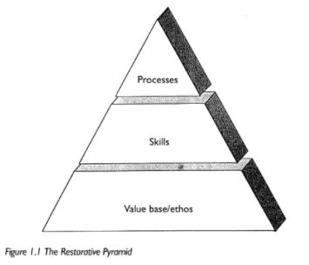
Just Schools: A Whole School Approach to Restorative Justice, Belinda Hopkins (2003)
Notes:
Having a restorative mindset, enabling and empowering people to practice restoratively and adapting systems/processes to make it a reality

Slide 15
Whole-school approach to meeting people’s needs

Slide 16
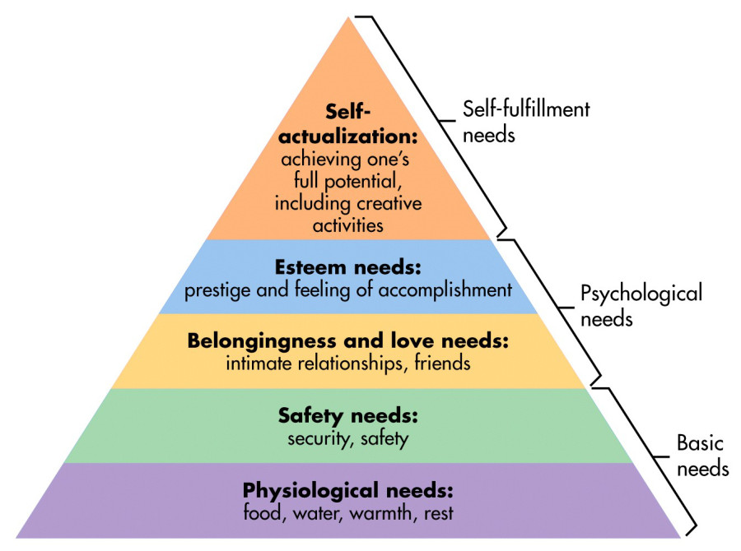
Belonging and Connectedness / Esteem / Relationships
Do people see themselves and their families reflected in the curriculum/school community?
Does your school see behaviour as a communication of unmet needs? Do you boost children/colleagues with low esteem?
Is hurtful behaviour/bullying dealt with consistently and effectively? Are people ‘worked with’ instead of ‘done to’?
SEND

Slide 17
Berne’s Psychological Hungers (1950s)
According to Eric Berne, in order to feel emotionally satisfied and healthy, humans need: Contact, Recognition, Incident, Stimulus, Structure and Passion.
The three fundamental needs being:
Stimulation – Is what’s happening in and outside of the classroom purposeful?
Structure - Safe and predictable routines from start to end of day? Are transitions safe and predictable?
Recognition – Does every child feel like a valued member of the school community every day?

Slide 18
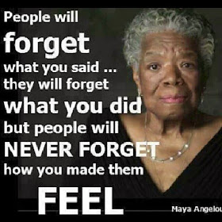
Thinking point to take away…
How do you go about meeting the needs of the people in your community? Is it only on laminated posters and in words spoken in assembly or do they feel it?
Belonging and Connectedness
Esteem
Friendship

Slide 19
Module 4 – Social Discipline Window
https://vimeo.com/729245374/c78b348af1

Slide 20
Module 5 - 5-step framework
https://vimeo.com/729246580/a5ff61f911

Slide 21
Module 6 - Demonstration of 5-step conversation
https://vimeo.com/670710830/4ac46726d0

Slide 22
Reflection on demo - Optional
What is the facilitator doing / not doing? What restorative values / qualities are being displayed?
How does a restorative conversation differ to other types of conversations you might have in school?
What might you need to consider before/during/after you have the conversation?
What worked well? Why?
What will you take away from this? How will this change how you approach conversations with children/adults affected by conflict?
Do you feel more confident in having a go as a result of seeing this?
Is there anything else you need to feel confident in managing conflict in your work?

Slide 23
Skills Practice - Optional
PRIMARY:
In pairs, use the 5-step framework to work through a conversation with Josh, Leah or the teacher on duty.
SECONDARY:
In pairs, use the 5-step framework to work through a conversation with Josh, Liam or Mr James.

Slide 24
Module 7 – Restorative Scripts and Other Tools
https://vimeo.com/729250819/3e68925acb

Slide 25
Restorative Meeting Script 2 people
Intro: Facilitator explains reason for meeting and asks for honesty and good listening - each person will have their turn…
Perspectives: Person 1 then Person 2 – What happened for me was… It made me think… It made me feel… The hardest thing for me was…
Transition point: Facilitator asks Person 1 then Person 2 – Is there anything you would like to say at this point?
Needs: Facilitator asks Person 1 then Person 2 – What do you need for things to be better?
What now? Facilitator asks what they feel needs to happen now…
Hopes… Facilitator asks both: Is there anything that you hope to come out of this meeting?

Slide 26
Skills Practice – Optional
Using the restorative meeting script on Slide 24…
PRIMARY:
Set-up and work through a meeting between Josh and Leah OR Josh and the teacher on duty.
SECONDARY:
Set-up and work through a meeting between Josh and Liam OR Josh and Mr James.

Slide 27
Additional Sources of Information and Support
Restorative Practice | Schools (oxfordshire.gov.uk)
Oxfordshire Restorative Practice | Family Information Directory
TES article - Ask the expert: what is restorative practice?
Transforming Conflict
Restorative Justice Council | Promoting quality restorative practice for everyone
Recommended Reading List
Restorative Practice in School: An Introduction for Parents/Carers (video)
Why become a Restorative School? - for schools
Why become a Restorative School? - for parents/carers
Circles of Connection - Stories and reflections from people around Ireland using Restorative Practices in their work and life.
Mental health and wellbeing | Schools (oxfordshire.gov.uk)

Slide 28
Restorative Network for Oxfordshire Schools and Colleges
All schools who have received whole-school training in restorative approaches are invited to join 3x/year network meetings which enable like-minded schools to link up, share successes and work together to overcome common challenges.
Topical issues are explored (e.g. engaging parents, working restoratively with neurodiverse individuals) and specialist workshops organised to enable and empower schools to fully utilise and embed restorative approaches.

Slide 29
Restorative Approaches: Practitioner Course
This course is suitable for those members of staff who want to develop an in-depth knowledge of Restorative Practice, including facilitating restorative conversations and restorative meetings. The course content has a large component of skills practice enabling participants to practice using restorative skills and exploring how this links to their own context.
To book onto the above course, visit OSCB Courses - Oxfordshire Safeguarding Children Board

Slide 30
Advanced Support Offer
Restorative support for victims of significant harm
SAFE! Support for Young People Affected by Crime is a local charity which provides free, individually tailored support (up to 6 sessions) for young people who have been victims of crime and bullying who are finding it hard to recover their sense of safety and confidence. For further information about the support SAFE! offers including how to refer please visit:
https://www.safeproject.org.uk/

Slide 31
Should we involve the police?
Restorative support for perpetrators of significant harm
If you feel that a crime may have been committed, for example under the protection from Harassment Act 1997, the Malicious Communications Act 1988, the Communications Act 2003, and the Public Order Act 1986, Thames Valley Police Schools’ Officers are on hand to advise and offer support. Hate crimes are also illegal and should be reported to the police. Referrals will be considered on a case-by-case basis and, where appropriate, restorative interventions offered.
To make a request, schools should contact their School Police Officer directly.

Slide 32
Fairness

Slide 33
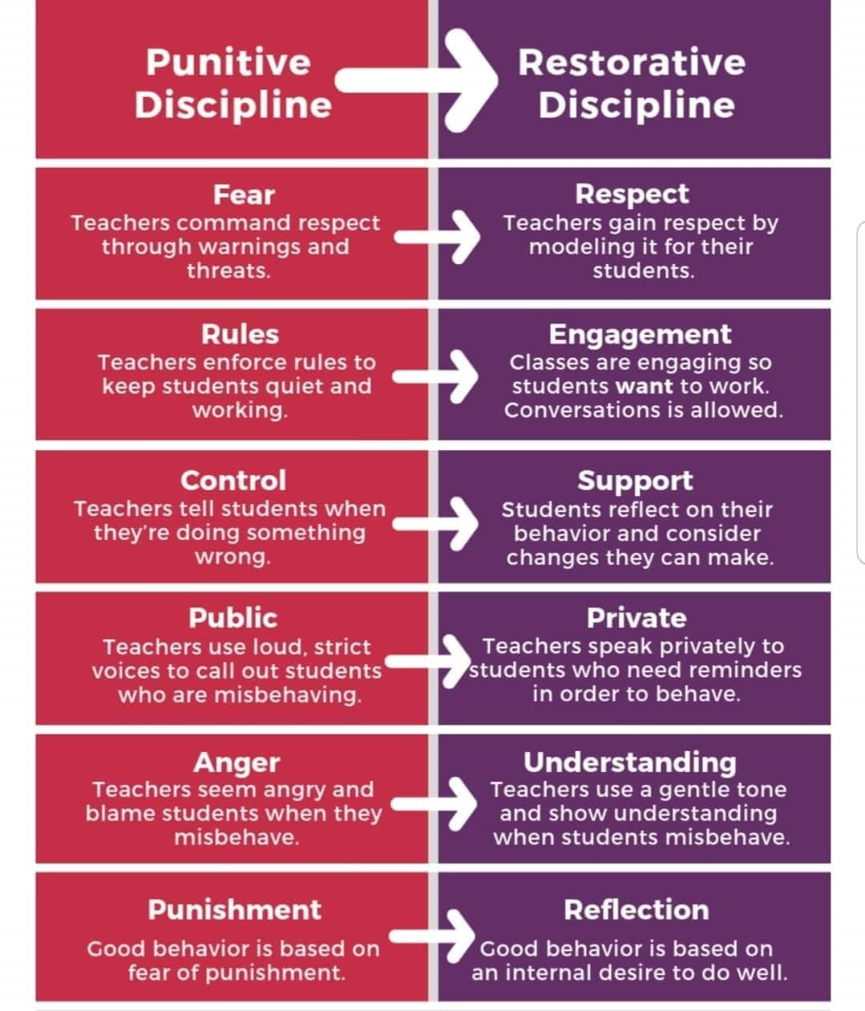
Approaching Discipline with a Restorative Mindset
Notes:
Traditional vs restorative

Slide 34
Practising restoratively… CONNECT – LEARN TOGETHER
Attitude towards people:
Seeing the whole person in the context of the situation
Wanting the best for them and making time to talk – genuinely caring
Being open to vulnerability – human to human
Approach:
Working with people, free of judgement and with respect
Learn by listening – show compassion, empathy and understanding
Integrity (no secrets) – open and honest approach
Being ‘curious not furious’ - preserve dignity, reflect in private
Adopt a problem solving approach
Desired outcome:
Support people in moving on / addressing difficulties
Support people in feeling better (addressing needs) and empowering them to do things differently – helpful and hopeful / good for mental health and wellbeing
To reduce the likelihood of conflict/recurrence of conflict
Learning opportunity - If I do this… The consequences are…
Authentic reparation

Slide 35
What is not restorative… BLAME - ALIENATE
Attitude towards people:
Being quick to judge and blame
Not accepting of unconscious biases
Approach:
Autocratic decision making
Obsession on violation on rules and compliance
Focuses on guilt/compliance/punishment for learning – shame and humiliate
Quick to impose sanctions, remove the problem or exclude
‘I don’t have time for this’ attitude
Desired outcome:
Expects immediate results: compliance and respect
Apology – genuine or not
Notes:
Focuses on guilt/compliance/punishment for learning
Focuses on the violation of rules and expects compliance – doesn’t see behaviour as communication of potential unmet needs

Slide 36
As a result of today’s training, I will…

Slide 37
As a result of today’s training, we will…

